Slide 1
CSML1010 – Final Project
Group 11 – Alex Fung and Patrick Osborne
Instructor – Dr. En-Shiun Annie Lee

Slide 2

Twitter US Airline – Sentiment Analysis
Dataset from Twitter
14,640 thousand tweets
15 Features
6 US Airlines
Positive | Neutral | Negative
Aligns with a business problem
How to stop negative tweet trends before they go out of control?
Identify the early tweets accurately -> Sentiment Analysis!
Presents an interesting ML/Data challenge
Data is messy (Twitter character limit, slang, emojis, @ and #)

Slide 3

Existing Work - Academia
“Sentiment Analysis of Twitter Feeds” - Yogesh Garg, Niladri Chatterjee
https://link.springer.com/chapter/10.1007/978-3-319-13820-6_3
Similar angle for Tweet Sentiment classification -> intended for use in business context
Similar problems in parsing slang/unique features
“Twitter Sentiment Analysis with Deep Convolutional Neural Networks” - Aliaksei Severyn, Alessandro Moschitti
https://dl.acm.org/doi/abs/10.1145/2766462.2767830
Different approach than us – using Deep Learning rather than traditional methods
“Emoticon Smoothed Language Models for Twitter Sentiment Analysis” - Kun-Lin Liu, Wu-Jun Li, Minyi Guo
https://www.aaai.org/ocs/index.php/AAAI/AAAI12/paper/viewPaper/5083
Unique approach - trains language model on manually labelled tweets - uses emoticon and hashtag data for smoothing

Slide 4



Existing Work - Industry
Existing Software Products providing Twitter Sentiment Analysis:
NCSU Tweet Sentiment Visualization App Software
https://www.csc2.ncsu.edu/faculty/healey/tweet_viz
Mention
https://mention.com
Social Searcher
https://www.social-searcher.com/
Many others available – some integrated into CRMs/other marketing software

Slide 5


Loading/Cleaning Data
Loading Data
Available as CSV and SQL
UTF-8 encoding to preserve emojis 👍
Twitter data notoriously unclean
Character limit forces non-standard English
Remove noise for sentiment analysis
@ Mentions, RT re-tweets
Retain value-adds
Emojis 💻, hashtags #
Add important context and content
Clean text itself
Remove HTML, translate slang, remove STOP words and grammar, lemmatize

Slide 6
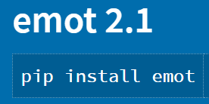
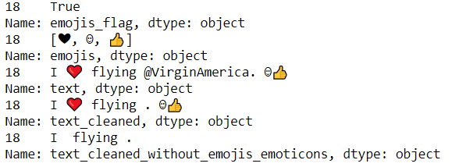
Data Cleaning Challenges
How to extract emojis?

Slide 7
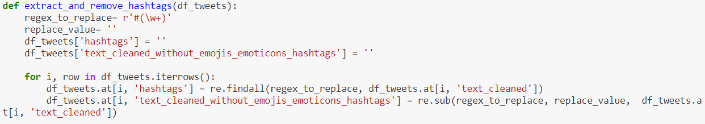
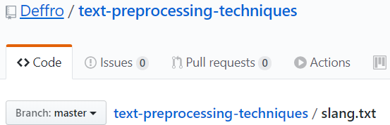
Data Cleaning Challenges
Extract Hashtags?
Text to lowercase
Convert Slang
Find and replace based on an existing dictionary

Slide 8

Text Cleaning
Remove stop words
“The”, “and”, “You”, etc. -> noise
Remove punctuation & numbers
Lemmatize
Tokenize

Slide 9
Data Exploration
15 columns
6 main features that interest us
airline_sentiment
airline_sentiment confidence
negativereason
negativereason_confidence
airline
text
Engineered Features
emojis
emoticons
cleaned text (lemmas)

Slide 10
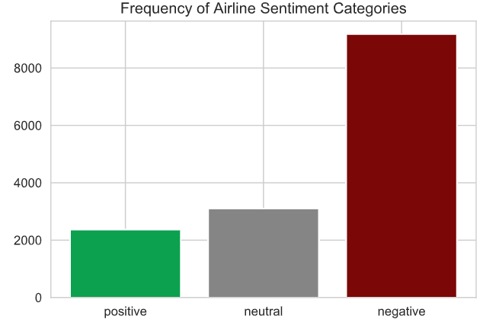
Data Exploration

Slide 11
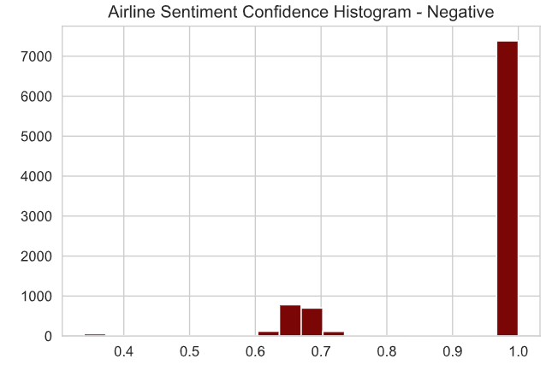
Data Exploration

Slide 12
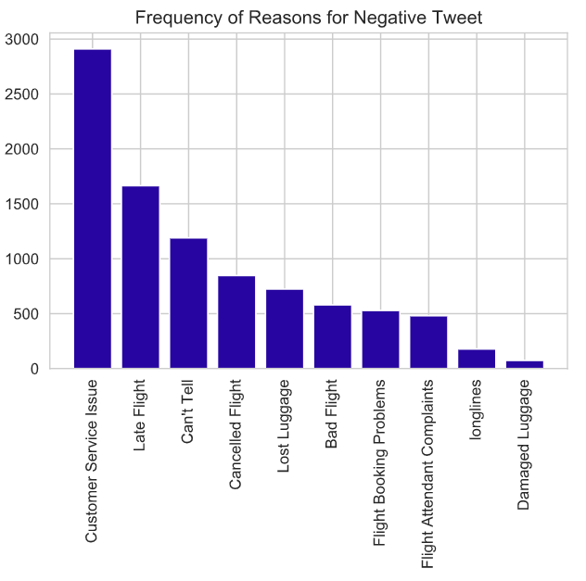
Data Exploration

Slide 13
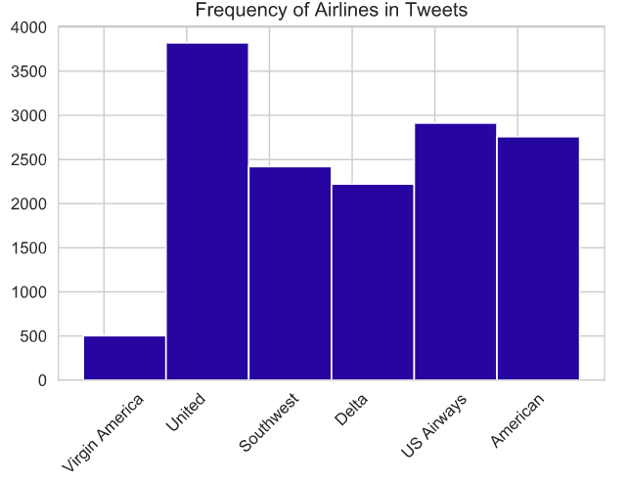
Data Exploration

Slide 14
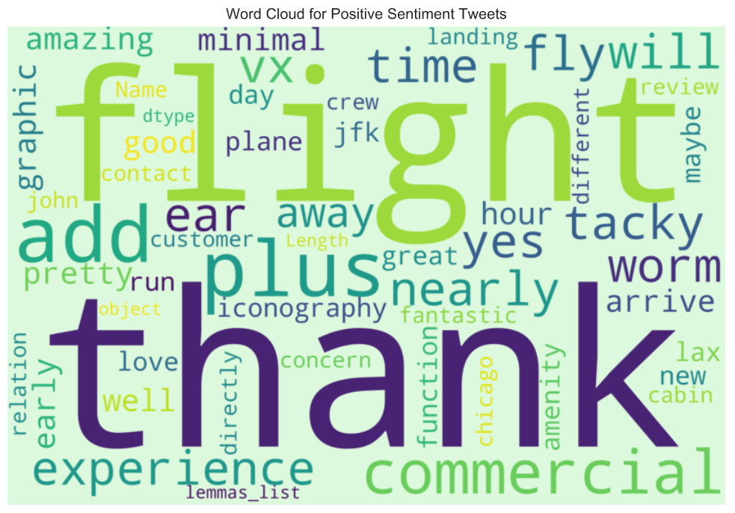
Data Exploration

Slide 15
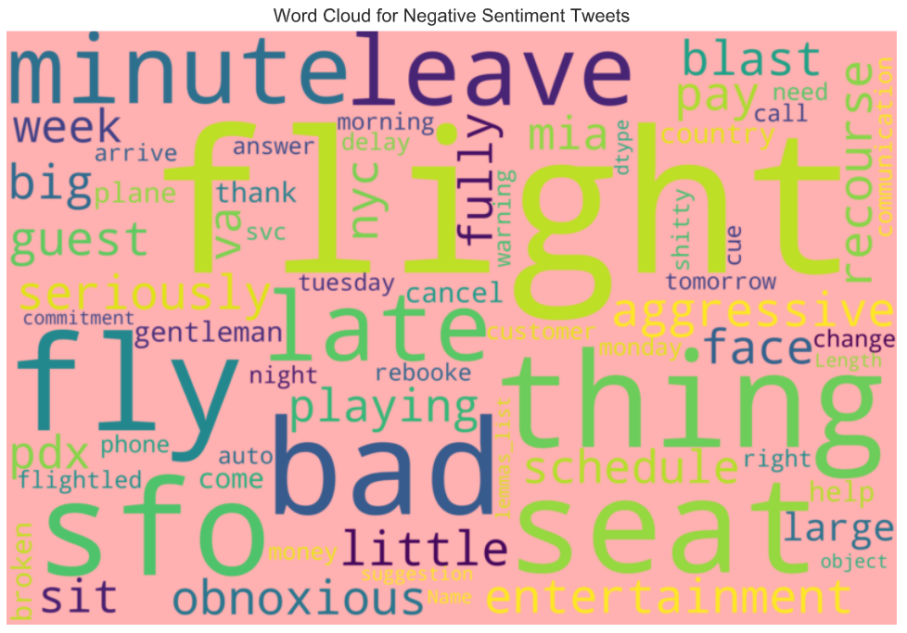
Data Exploration

Slide 16
Data Exploration – Emojis & Hashtags
Is there value in the extracted emojis and hashtags?
Method:
Plot frequency by sentiment class (positive, neutral, negative)
If there is a clear difference – emojis & hashtags are differentiators -> add context

Slide 17
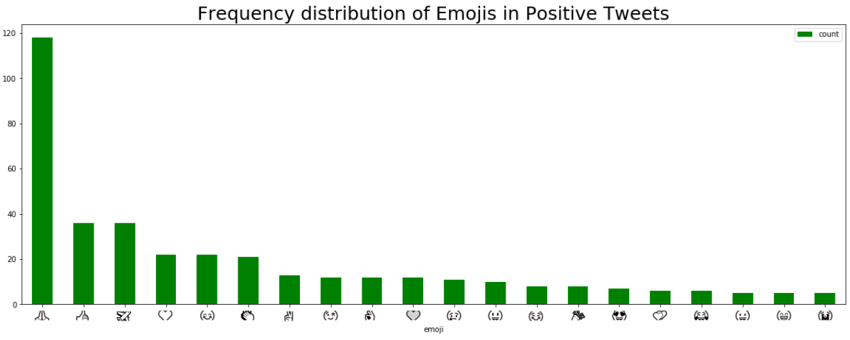
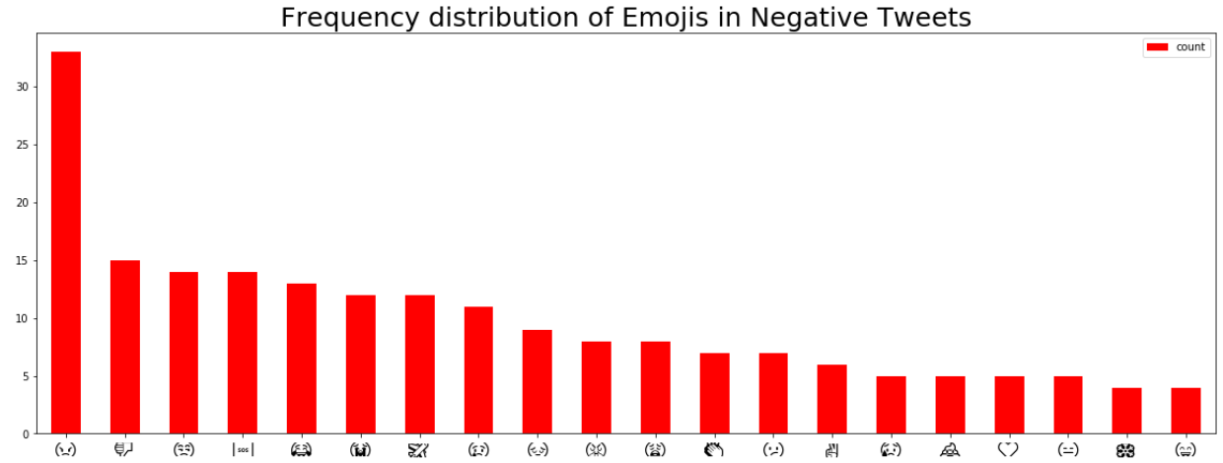

Slide 18
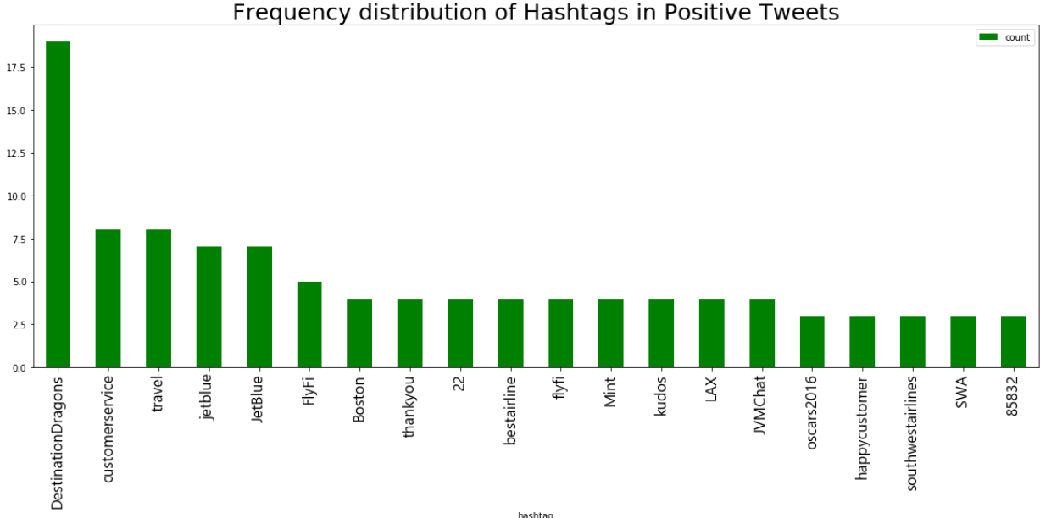
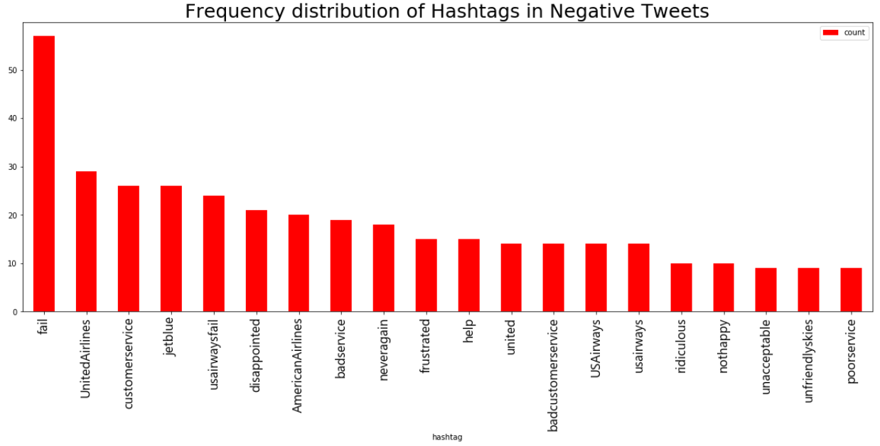

Slide 19
Data Exploration – Emojis & Hashtags
Issues with our emoji, emoticon and hashtag extraction
Extraction process confuses non-emoticon string of characters for an emoticon
E.g. time of day, airport codes
Hashtags could be cleaned further
Reduce to lowercase, remove stop words, lemmatize
Challenging as hashtags are not pure English

Slide 20
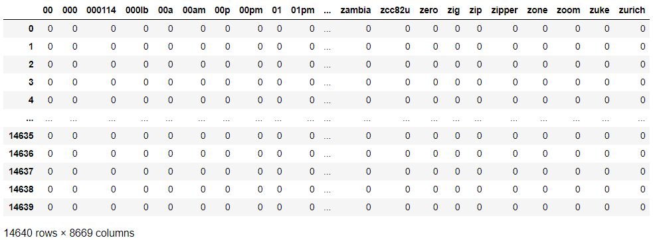

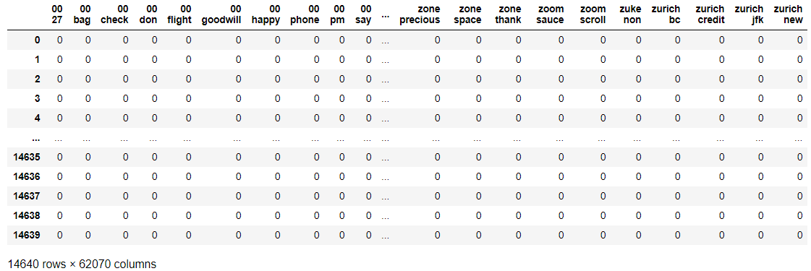
Feature Engineering – Basic Methods
Bag of Words
Bag of N-Grams

Slide 21
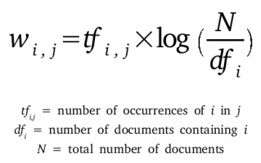
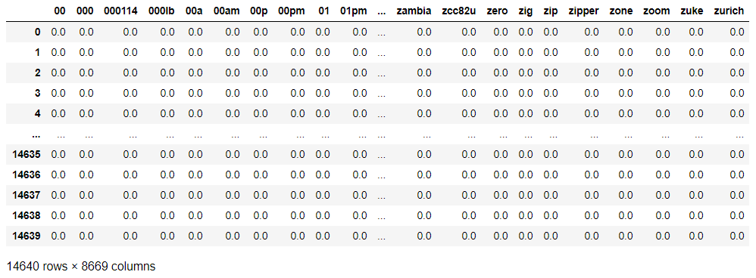
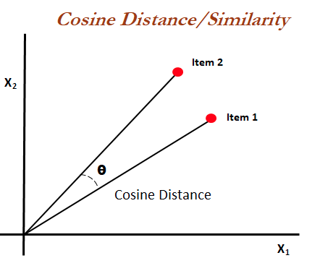
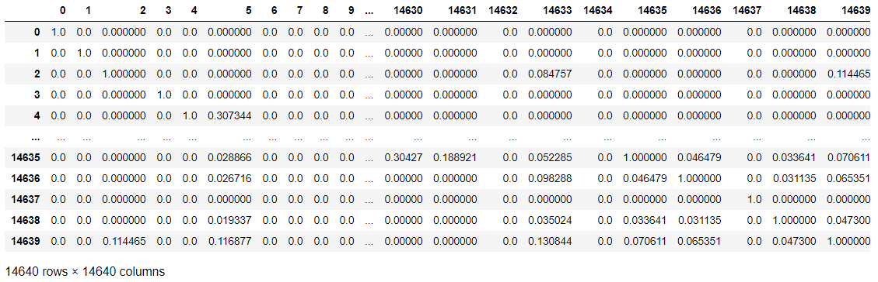
Feature Engineering – Basic Methods
TF-IDF
Cosine Similarity

Slide 22
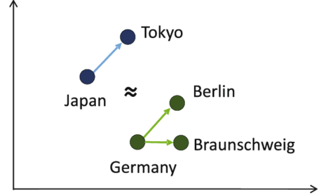
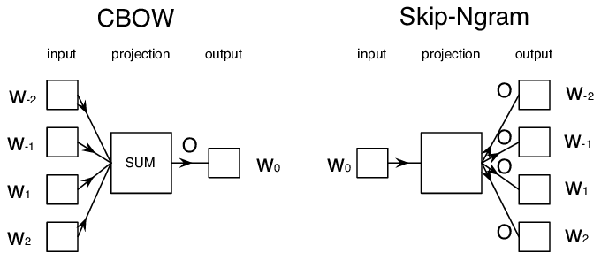
Feature Engineering – Word2Vec
Word2Vec
A form of word embedding
Represent individual words in a way that
similar words are represented in similar
ways
Generates numerical vectors
CBOW vs Skip-gram
Frequency/speed/accuracy trade-offs

Slide 23



Feature Engineering – Word2Vec - Models
Tensorflow / Keras Trained
Manual process
Slow even when GPU accelerated
Gensim Trained
Very fast
Possibly less fine-grained control
Google Pre-Trained
Fastest
Advantage of training on existing corpus
Cannot custom train to our dataset

Slide 24

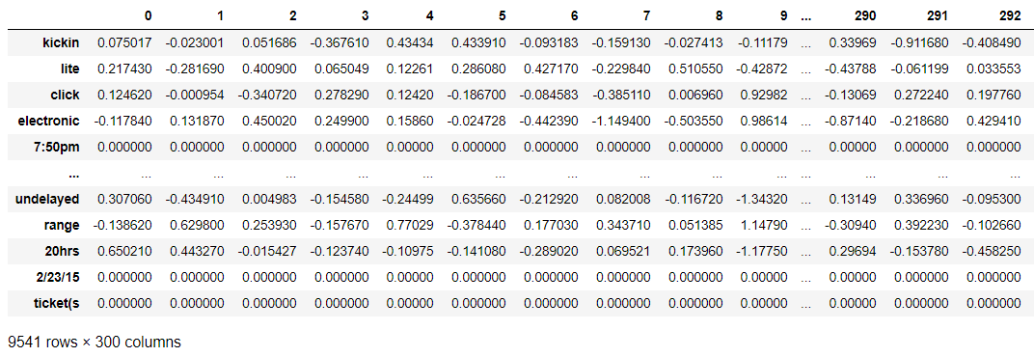
Feature Engineering – GloVe
GloVe Word Embedding
Global Vectors for Word Representation
An alternate model

Slide 25
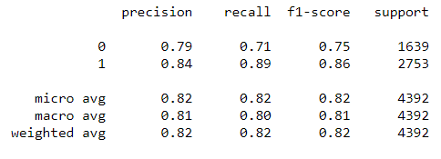
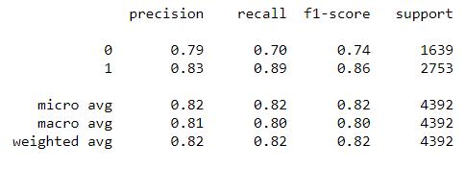
Benchmarking – Logistic Regression
Gensim Word2Vec Word Embeddings
Google Word2Vec Pre-Trained Word Embeddings

Slide 26
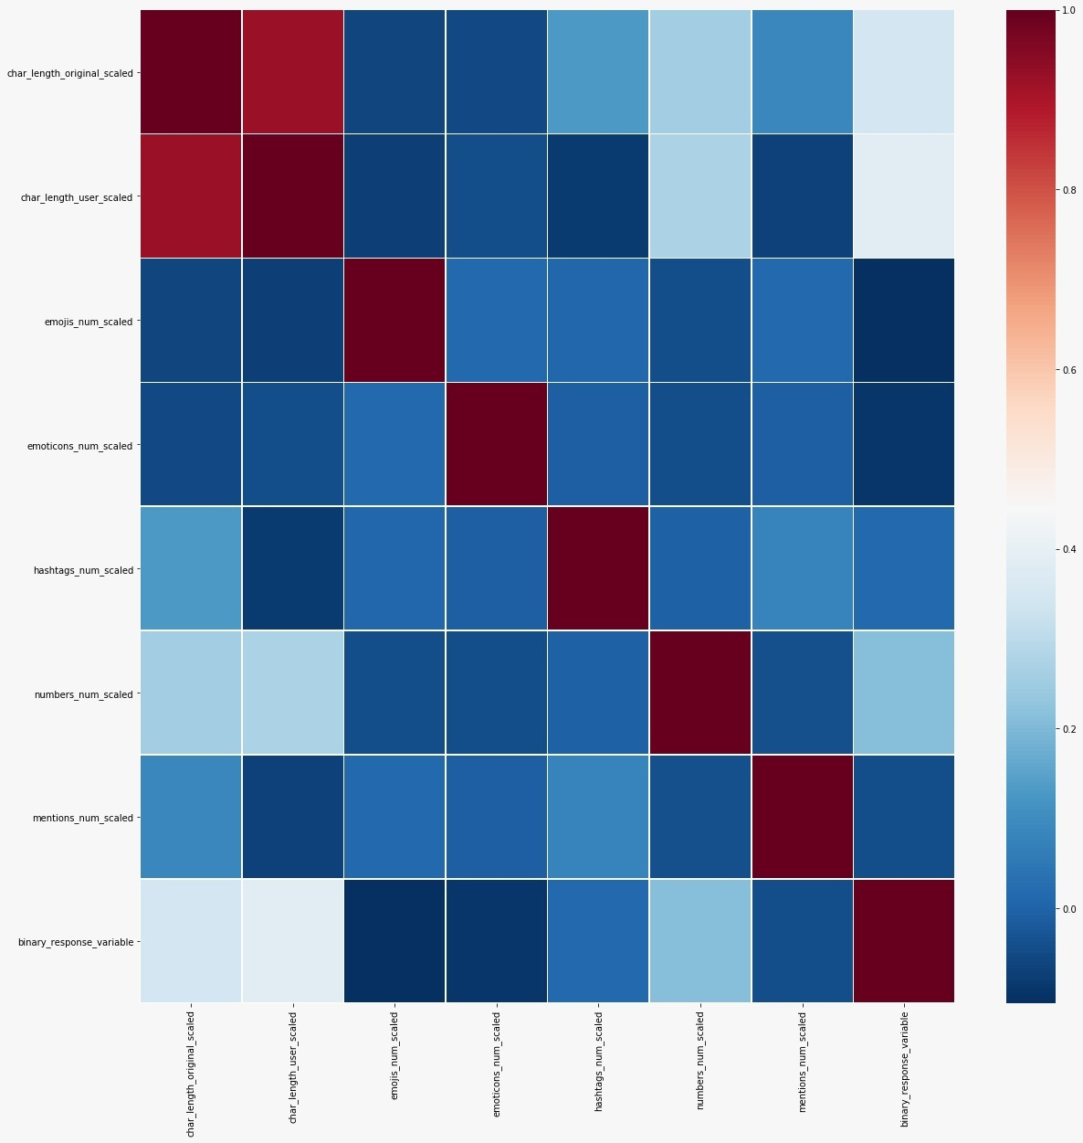
Feature Selection
Correlation Matrix
of
Engineered Features

Slide 27
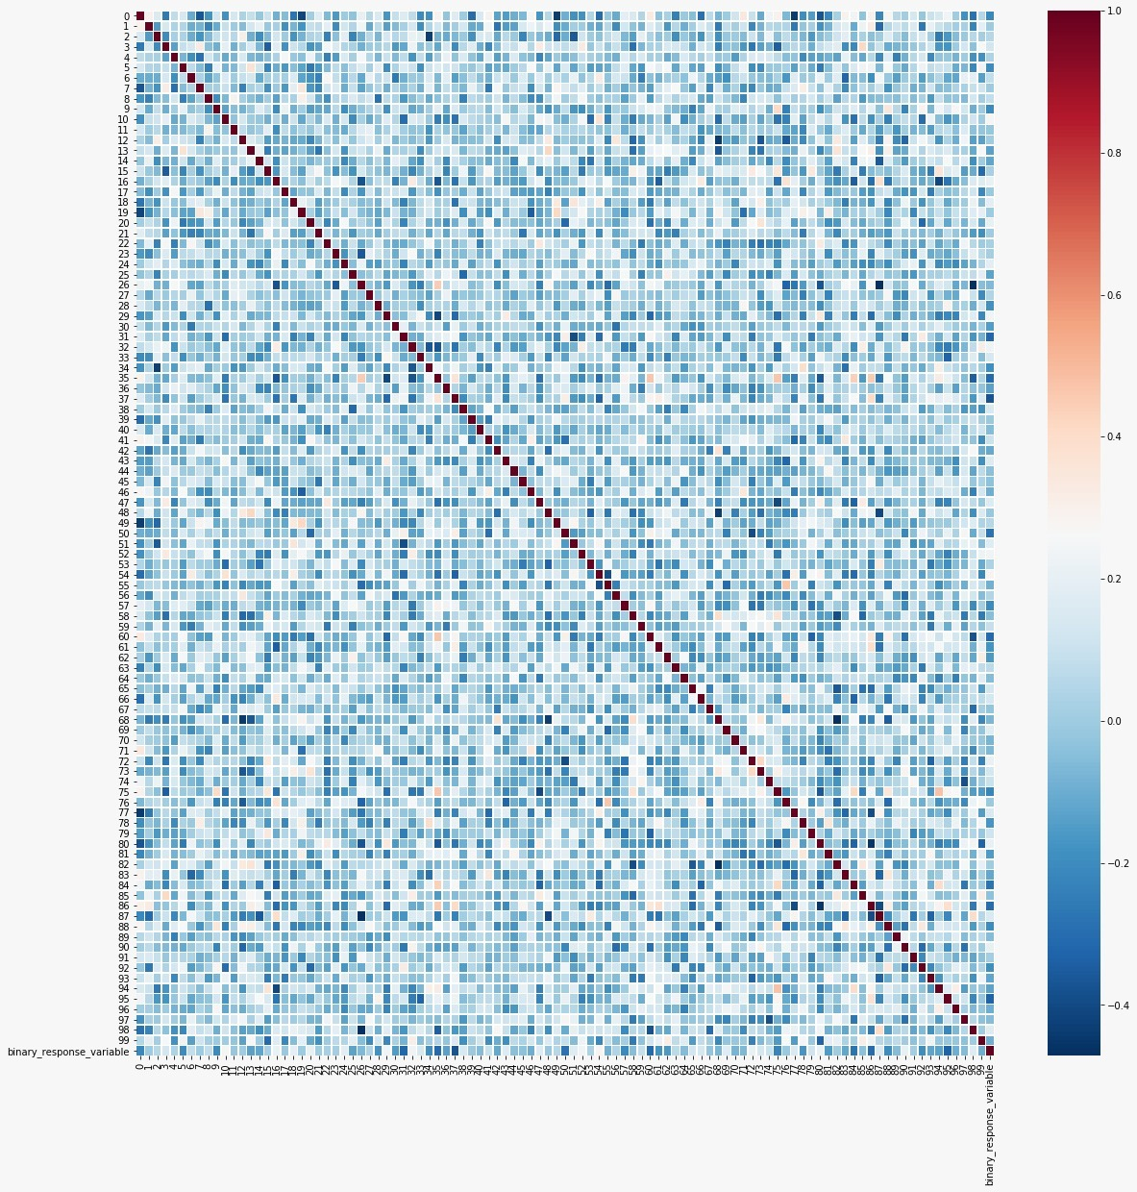
Feature Selection
Correlation Matrix
of
Gensim word2vec

Slide 28
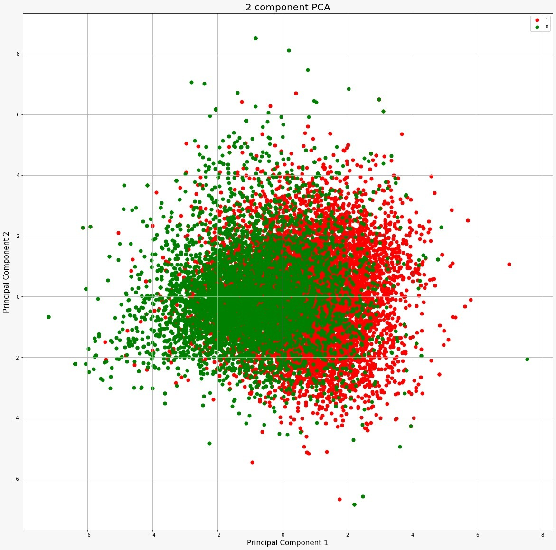
Principal
Component
Analysis
(Dimensionality
Reduction)

Slide 29
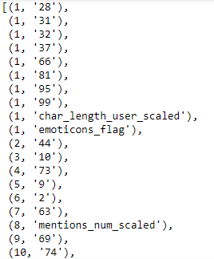
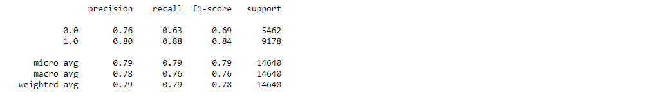
Feature Selection
Top 10 Features Ranked
Recursive
Feature
Elimination
Benchmark Results

Slide 30
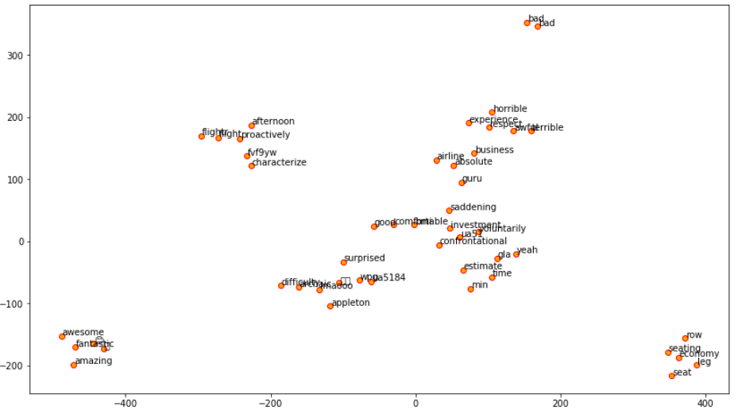
Feature Exploration
Gensim Word2Vec

Slide 31
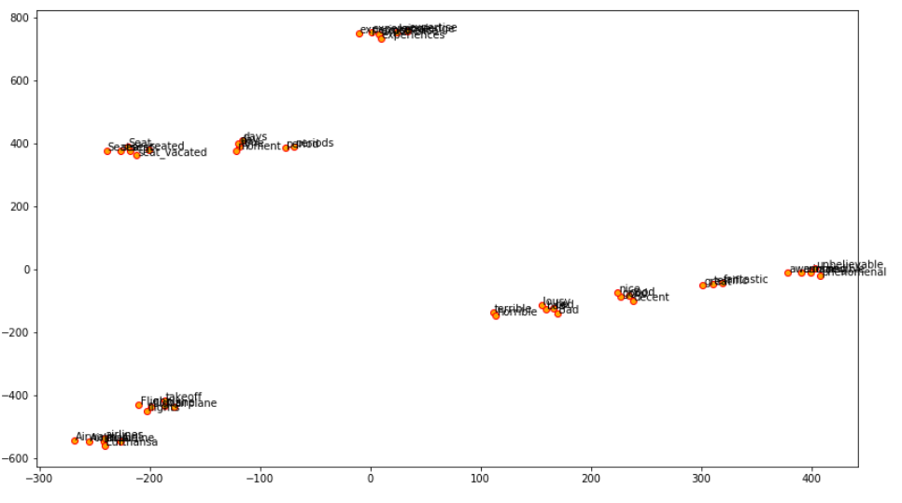
Feature Exploration
Google Word2Vec

Slide 32
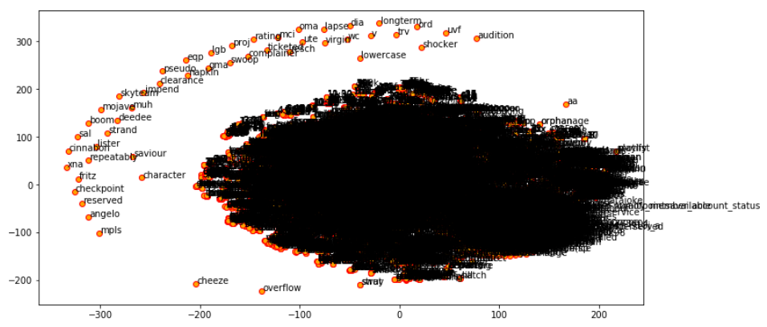
Feature Exploration
GloVe
All word embeddings

Slide 33
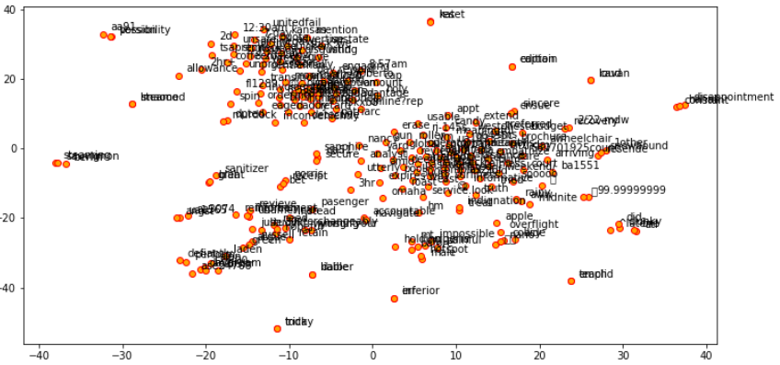
Feature Exploration
GloVe
250 item sample

Slide 34

Twitter US Airline – Sentiment Analysis
Combined Feature Engineered Dataset
Data is fully numerical now
Engineered Features
E.g. Emojis/Emoticons
Hashtags
Etc.
GloVe Word Embeddings
(300 dimension)
Binary response variable

Slide 35


Model Benchmarking – Supervised Learning
Supervised Models (Classification)
K Nearest Neighbors
Decision Tree
Support Vector Classifier
Gaussian Naïve Bayes
Logistic Regression

Slide 36
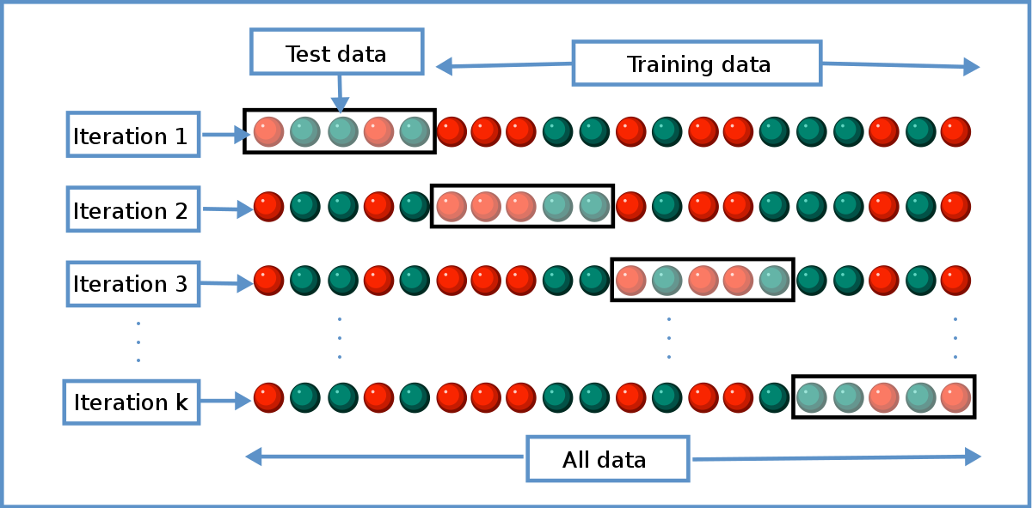
Model Benchmarking - Execution
Stratified K-fold Cross Validation
Using sklearn
Various Scorers:
Fit time, Score time, Bal. Accuracy, F1 score, F2 score, Precision, Recall, ROC-AUC

Slide 37
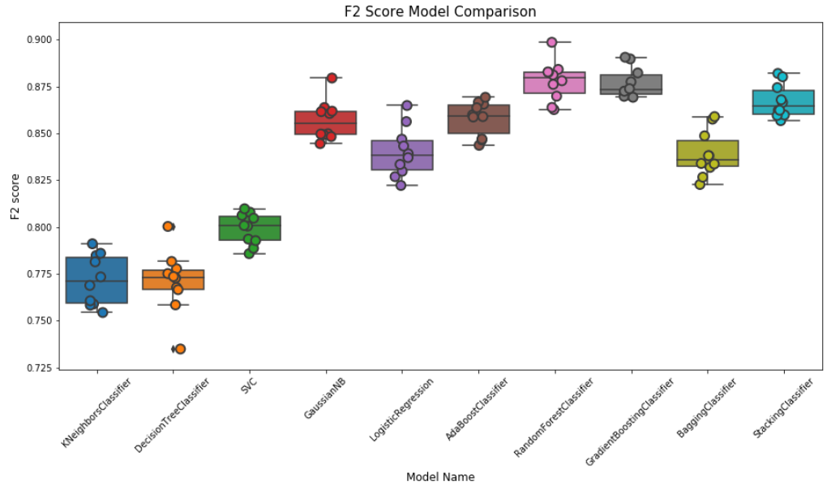
Model Benchmarking – F2 Score

Slide 38
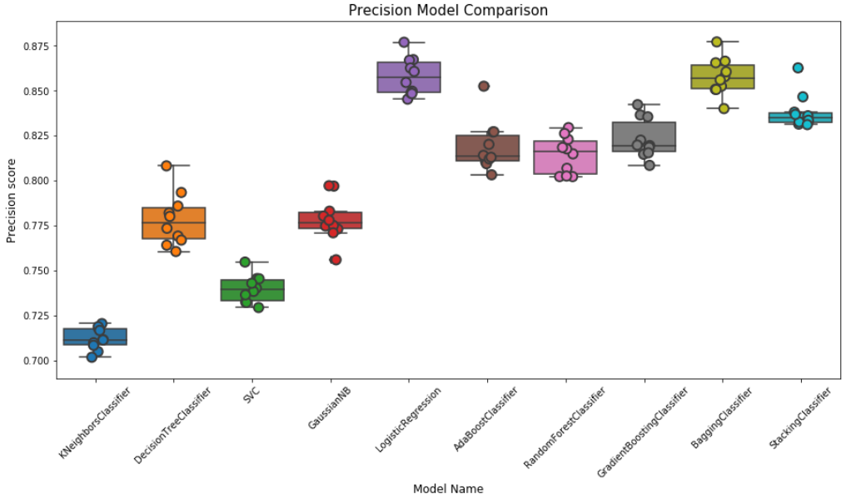
Model Benchmarking – Precision

Slide 39
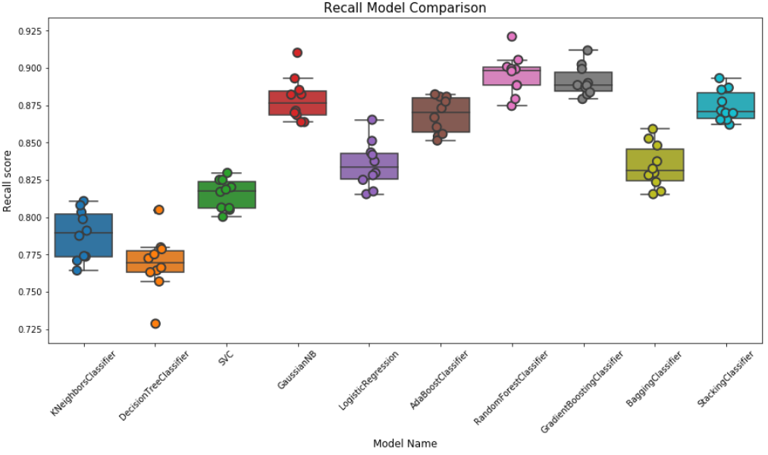
Model Benchmarking – Recall

Slide 40
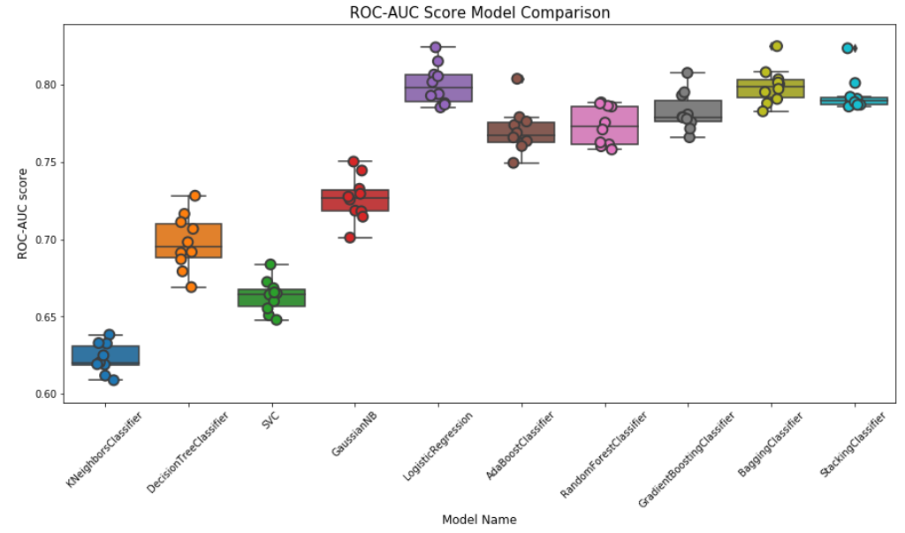
Model Benchmarking – ROC-AUC

Slide 41
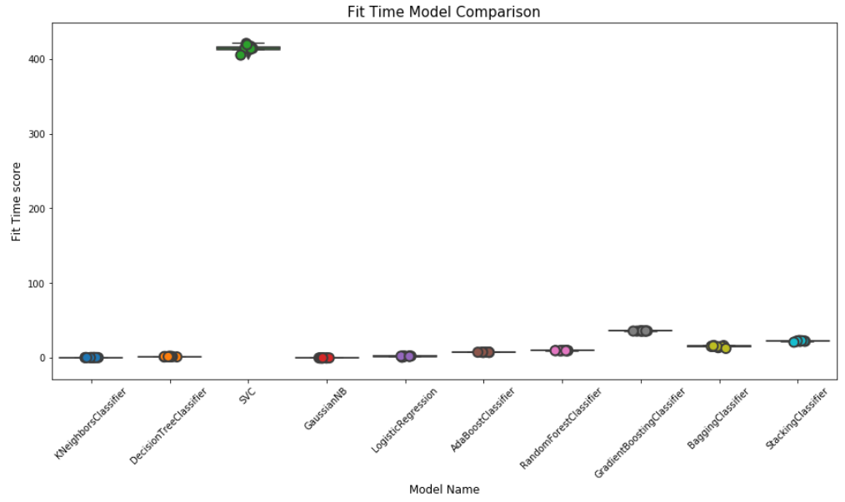
Model Benchmarking – Fit Time

Slide 42
Hyperparameter Optimization
Grid Search
Exhaustive test of parameters from a specified list
Time consuming, but certain to provide the best set of parameters
Random Search
Random search of provide parameters
Faster but could possibly miss some combinations of parameters

Slide 43
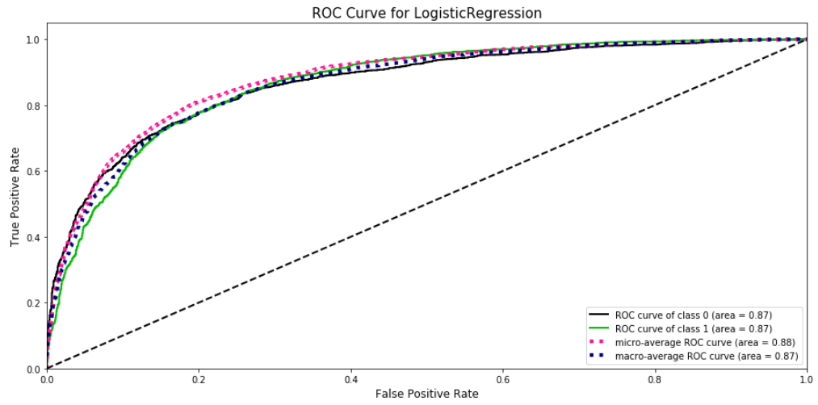
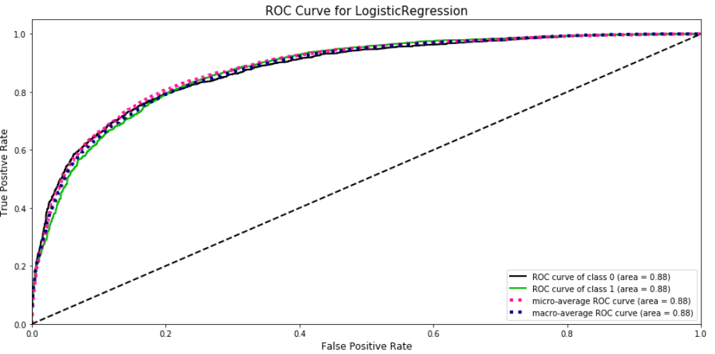
Hyperparameter
Optimization:
Logistic
Regression
Pre-optimization
Post-optimization

Slide 44
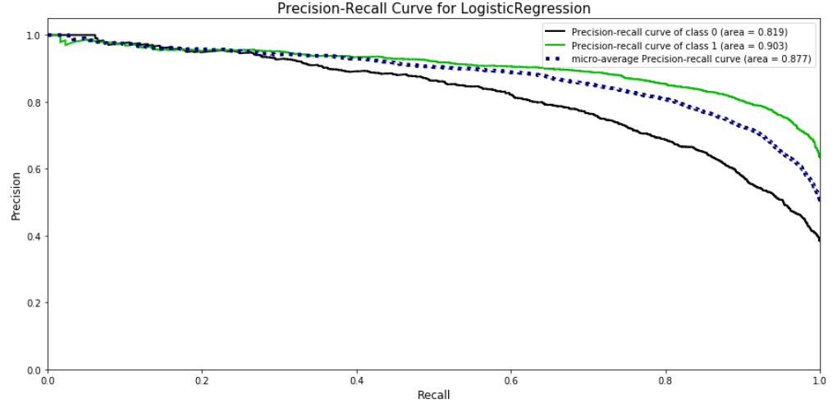
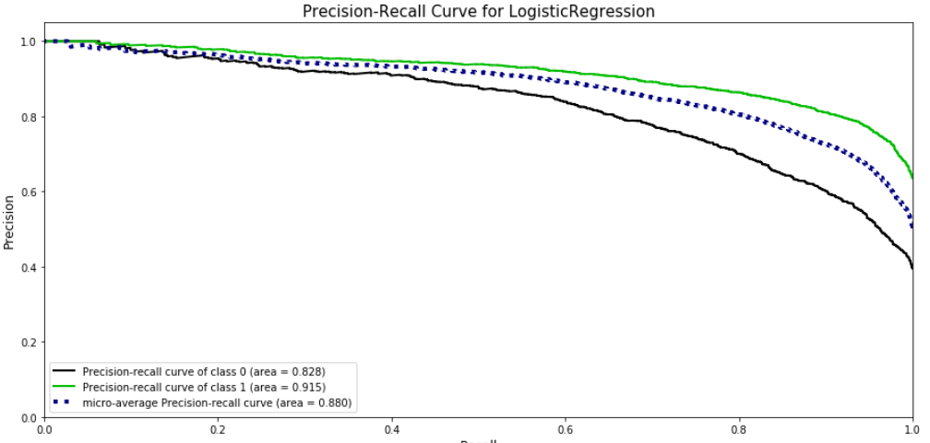
Hyperparameter
Optimization:
Logistic
Regression
Pre-optimization
Post-optimization

Slide 45
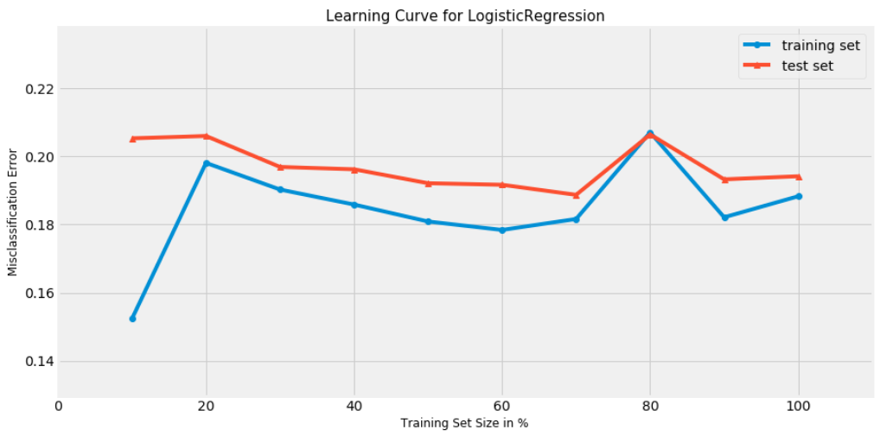
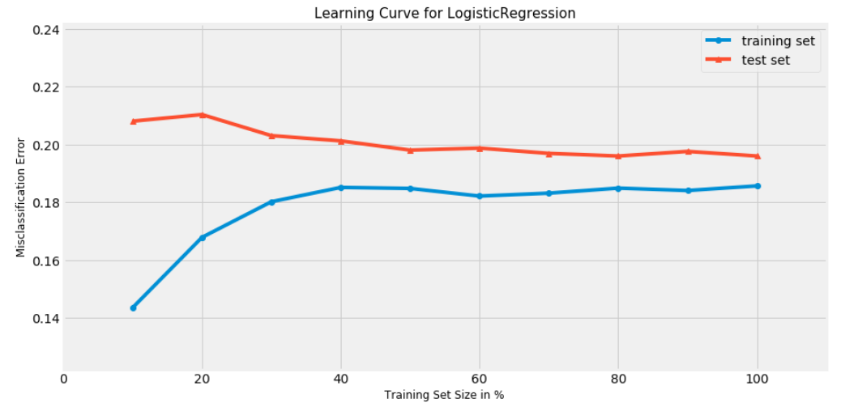
Hyperparameter
Optimization:
Logistic
Regression
Pre-optimization
Post-optimization

Slide 46
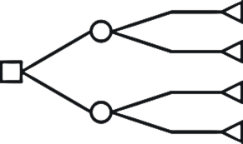
Ensemble Methods
Boosting
Gradient Boosting Machine
Ada Boost
Bagging
Random Forest
Bagging Classifier
Stacking
Stacking Classifier (sci-kit learn 0.22)

Slide 47
BERT – Model Results vs. Best of Rest
BERT (BiDirectional Encoder Representations for Transformers)
Used base uncased base BERT model
Metrics were the best, but fit/score time was very poor
Therefore, BERT was not chosen
Metric | BERT | Logistic Regression | GradientBoosting | Stacking
Fit Time (s) | ~300s | 1.91 | 32.21 | 21.86
Score Time (s) | ~60s | 0.03 | 0.01 | 0.06
F2 score | 0.888 | 0.839 | 0.877 | 0.867
Precision | 0.853 | 0.858 | 0.823 | 0.838
Recall | 0.869 | 0.835 | 0.891 | 0.875
ROC-AUC | 0.814 | 0.800 | 0.783 | 0.794

Slide 48
Model Selection
Using scores/metrics to select model
F2 score
Fit time (as this may need to be deployed)
Learning Curve
Precision-Recall Curve
Narrowed down list
Logistic Regression
Good fit time, good metrics - selected
Gradient Boosting Machine
Fit time and parameters too complex - rejected
Stacking
Good combination of base learners, fit time acceptable - selected

Slide 49
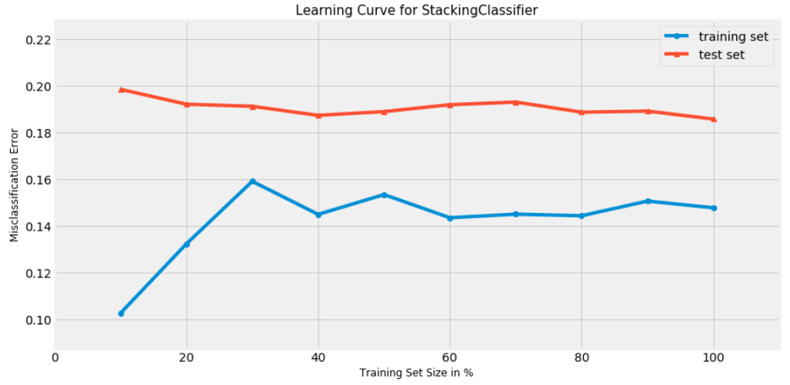
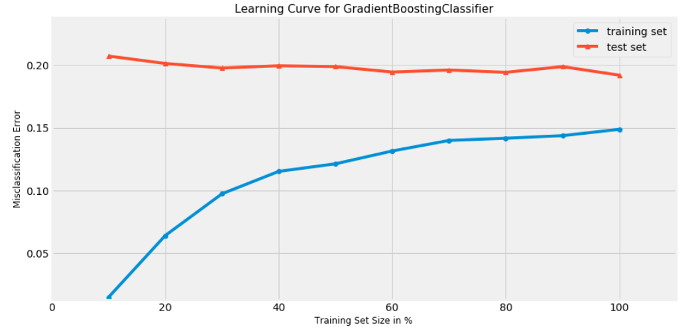
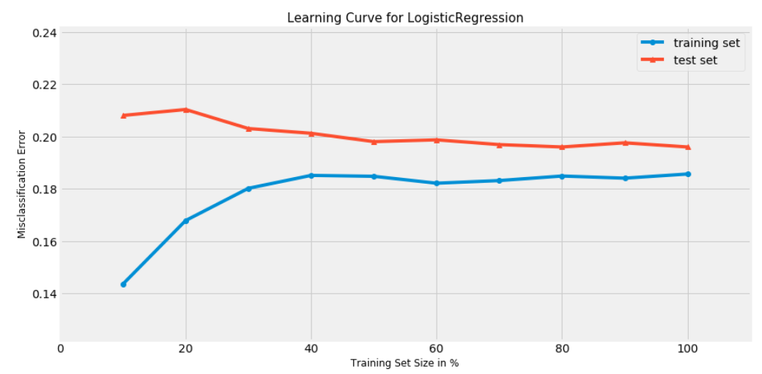
Model Selection – Learning Curve

Slide 50
Model Interpretability: Bias-Variance Tradeoff
GBM and Stacking have slightly superior metrics (F2 score, ROC-AUC, etc.), and minimally lower misclassification error, but their learning curves do not converge as closely as Logistic Regression
Indicates slightly lower bias, but greater variance
Logistic Regression converges better than ensemble models, but has minimally higher misclassification error
Indicates slightly higher bias, but lower variance

Slide 51
Model Interpretability / Risks and Bias
Need our models to be interpretable/explainable
Significant risk of bias/unfair decision making
Twitter is a volatile forum, users make decision based on inherent bias and opinions and are blunt
Need to understand how model is classifying based on our features
Both to avoid bias and to understand how it will react to new data

Slide 52
Model Interpretability: Feature Importance
Logistic Regression:
Feature: Unnamed: 0, Score: 0.00002
Feature: 0, Score: -0.10906
Feature: 1, Score: 0.07456
Feature: 2, Score: 0.27539
…
Feature: 99, Score: -0.12889
Feature: emojis_flag, Score: -0.05040
Feature: emoticons_flag, Score: -0.83323
Feature: hashtags_flag, Score: 0.36318
Feature: numbers_flag, Score: 0.12090
Feature: retweet_flag, Score: 0.00000
Feature: http_flag, Score: -0.48279
Feature: char_length_original_scaled, Score: 0.22784
Feature: char_length_user_scaled, Score: 2.85418
Feature: emojis_num_scaled, Score: 0.00000
Feature: emoticons_num_scaled, Score: 0.00000
Feature: hashtags_num_scaled, Score: -0.66614
Feature: numbers_num_scaled, Score: 0.00000
Feature: mentions_num_scaled, Score: -0.88700

Slide 53

Model Interpretability: Feature Importance

Slide 54






Model Interpretability – LIME
Negative
Positive
Neutral?

Slide 55
Conclusion
Generally speaking, most models performed well within the given metrics (F2, Precision/Recall, ROC-AUC)
Due to stringent data preparation, data cleaning, and feature engineering
Logistic Regression:
Fastest to train
Best in ROC-AUC, and Precision
Slightly higher Bias, Lowest Variance
More “neutral” bias between Precision/Recall
Gradient Boosting/Stacking:
Relatively slow to train
Best in F2 Score, and Recall
Lower Bias, Low Variance
Biased towards Recall than Precision

Slide 56
Recommendations
We would deploy Logistic Regression Model to Production
Why?
Very Fast Fit Time
Fast Score Time
Fairly small tradeoff in other metrics, such as F2 score, Recall, and ROC-AUC
Given the fast-pace nature of Twitter, it is just as important to train new models, and generate predictions quickly whilst maintaining high metrics
This is why we recommend deploying the Logistic Regression model to Production

Slide 57
Future Works
Exploration of other advanced algorithms/models that better understands words in a contextual manner:
Uni-Directional Neural Networks:
Recurrent Neural Networks (RNN)
Convolutional Neural Networks (CNN)
Bi-Directional Models:
ELMo (Embeddings from Language Models)
Further investigation into BERT (Bi-Directional Encoder Representations from Transformers)
Explore different similar NLP use cases related to the sentiment analysis:
E.g. multi-class sentiment analysis, sarcasm detection, writing styles, etc.

Slide 58
Thank You!

